Slide 1
March 29, 2023

Slide 2
The Fibery Library Data meets Crafting
Samara Cary, Simon Stone, Stephen Krueger, Tara Custer
Dartmouth Library

Slide 3
Before we begin, some notes:
It's ok to opt out after today or at anytime during the project
There will be scheduled meetings to work on these together
Please ask us questions
If you have ideas for future projects, let us know

Slide 4
Makers' Meetup
First meeting was March of 2022
Crafting with library colleagues. How to involve the Library?
Ideas were discussed:
creating group projects – using library data somehow
Invite guest speakers or have staff present their craft
A lot of interest but nothing initiated in 2022

Slide 5
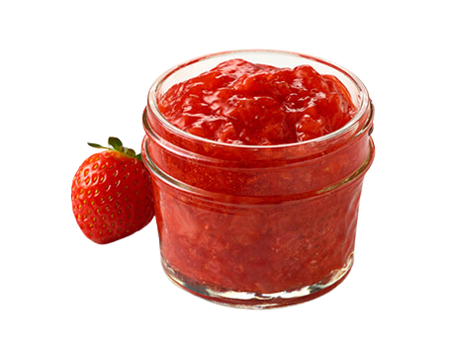
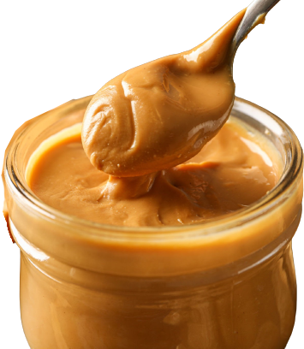
Research Data Services
In September 2022, a new department is established in the library
Part of its mission:
Get the library and the campus excited about working with data!
A department that wants to promote creative and fun ways to use data
A group that wants to promote fun things to craft

Slide 6
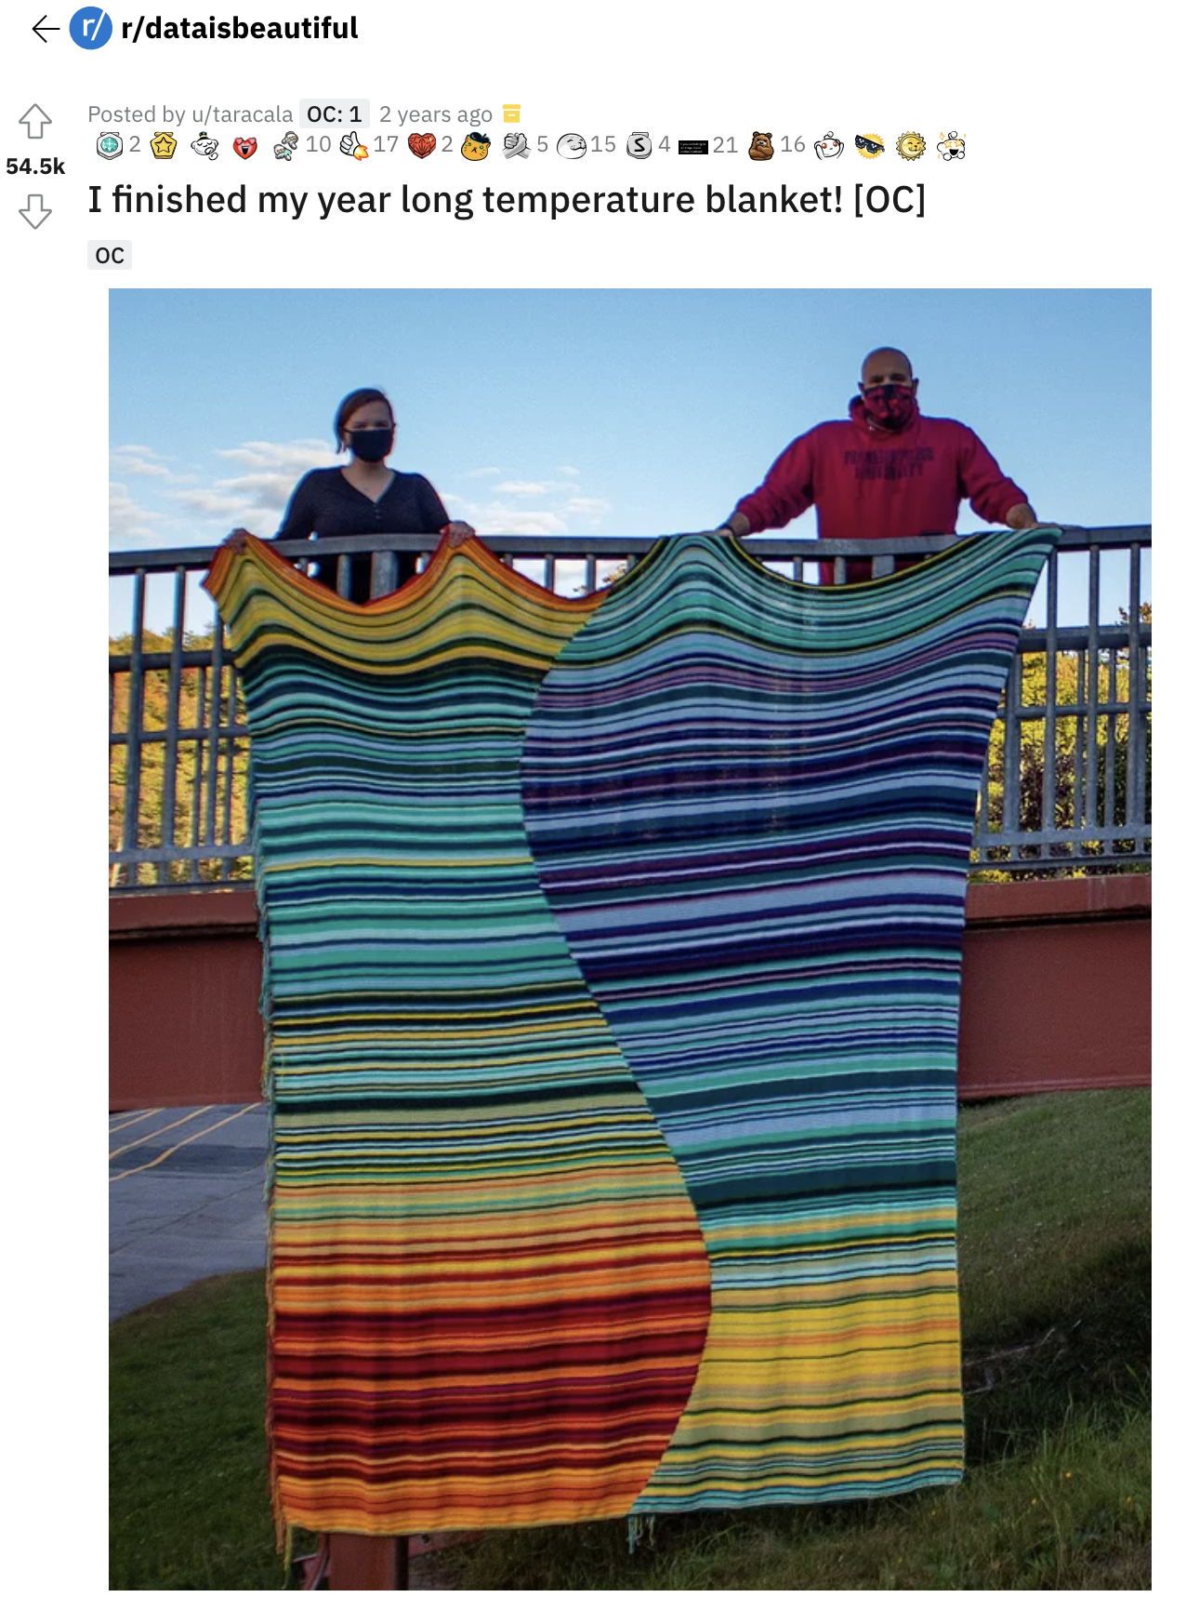
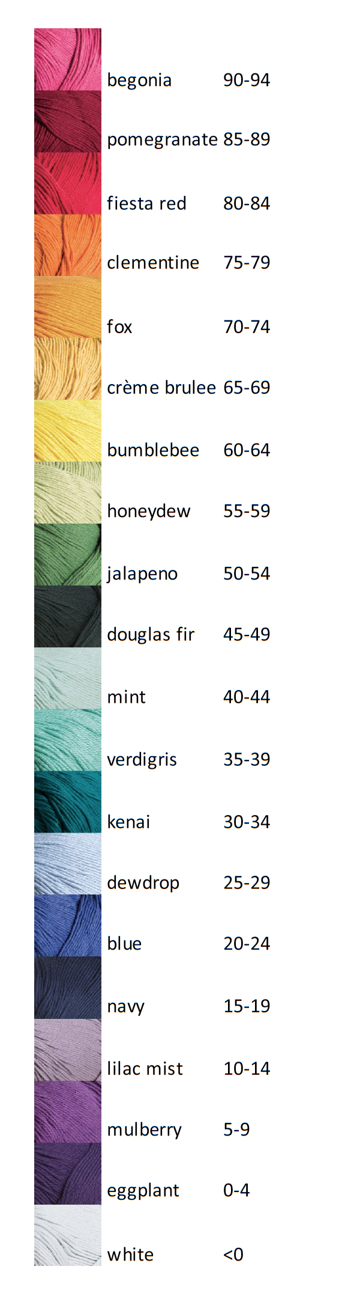
Meanwhile, on the internet:
Color to temperature (°F)
Daily low temperature
September 21, 2019
https://www.reddit.com/r/dataisbeautiful/comments/ixvyfw/i_finished_my_year_long_temperature_blanket_oc/
Daily high temperature
Proportion day to night
September 20, 2020

Slide 7
Very cool!
But needs more library…
Meanwhile, on the internet:
Color to temperature (°F)
Daily low temperature
September 21, 2019
https://www.reddit.com/r/dataisbeautiful/comments/ixvyfw/i_finished_my_year_long_temperature_blanket_oc/
Daily high temperature
Proportion day to night
September 20, 2020

Slide 8

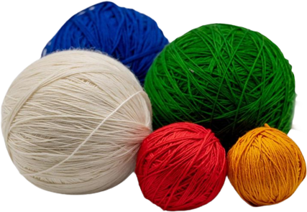

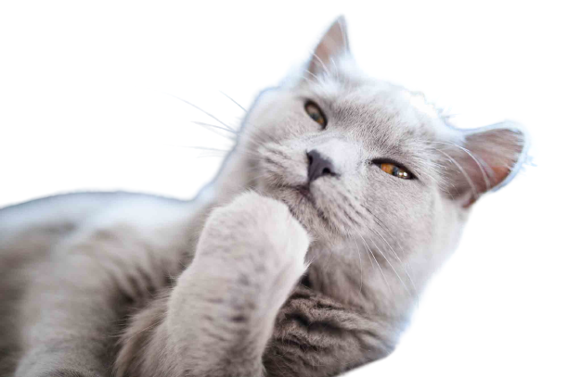
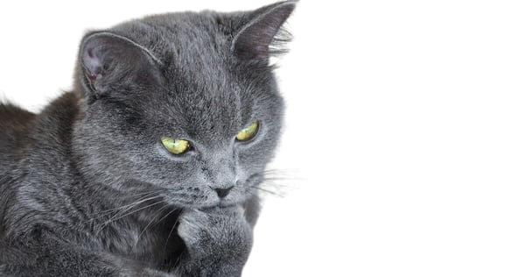
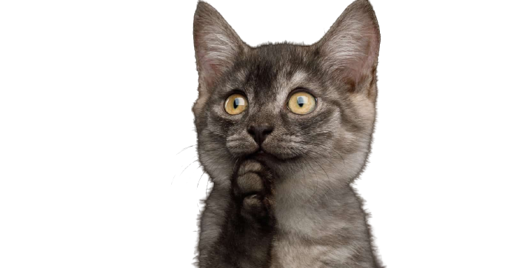
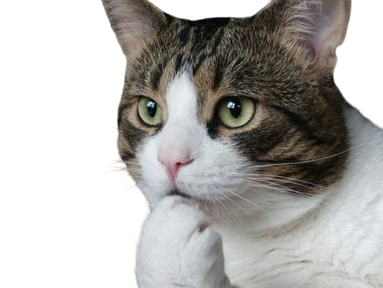
That got us thinking…
(scene re-enacted)

Slide 9
What we need
Numerical data
Sampled daily
Changes in interesting patterns
Meaningful to a large audience
Collections data by subject? By floor? By library?
📚 The number of items checked out each day! 📚

Slide 10
The raw data (thank you Danada!)
 | Alum | DHMC Staff | Faculty | Graduate | Guests | Interlibrary Loan | Sponsored | Staff | Undergraduate
2022-01-01 | 0.0 | 0.0 | 0.0 | 0.0 | 0.0 | 0.0 | 0.0 | 0.0 | 0.0
2022-01-02 | 0.0 | 0.0 | 12.0 | 5.0 | 1.0 | 0.0 | 0.0 | 1.0 | 4.0
2022-01-03 | 0.0 | 0.0 | 87.0 | 9.0 | 0.0 | 128.0 | 0.0 | 13.0 | 79.0
2022-01-04 | 0.0 | 0.0 | 116.0 | 26.0 | 0.0 | 239.0 | 0.0 | 22.0 | 83.0
2022-01-05 | 0.0 | 4.0 | 46.0 | 20.0 | 0.0 | 79.0 | 0.0 | 15.0 | 117.0
... | ... | ... | ... | ... | ... | ... | ... | ... | ...
2022-12-27 | 0.0 | 0.0 | 0.0 | 0.0 | 0.0 | 0.0 | 0.0 | 0.0 | 0.0
2022-12-28 | 0.0 | 0.0 | 0.0 | 0.0 | 0.0 | 0.0 | 0.0 | 2.0 | 0.0
2022-12-29 | 0.0 | 0.0 | 0.0 | 0.0 | 0.0 | 0.0 | 0.0 | 0.0 | 0.0
2022-12-30 | 0.0 | 0.0 | 0.0 | 0.0 | 0.0 | 0.0 | 0.0 | 0.0 | 0.0
2022-12-31 | 0.0 | 0.0 | 0.0 | 0.0 | 0.0 | 0.0 | 0.0 | 0.0 | 0.0

Slide 11
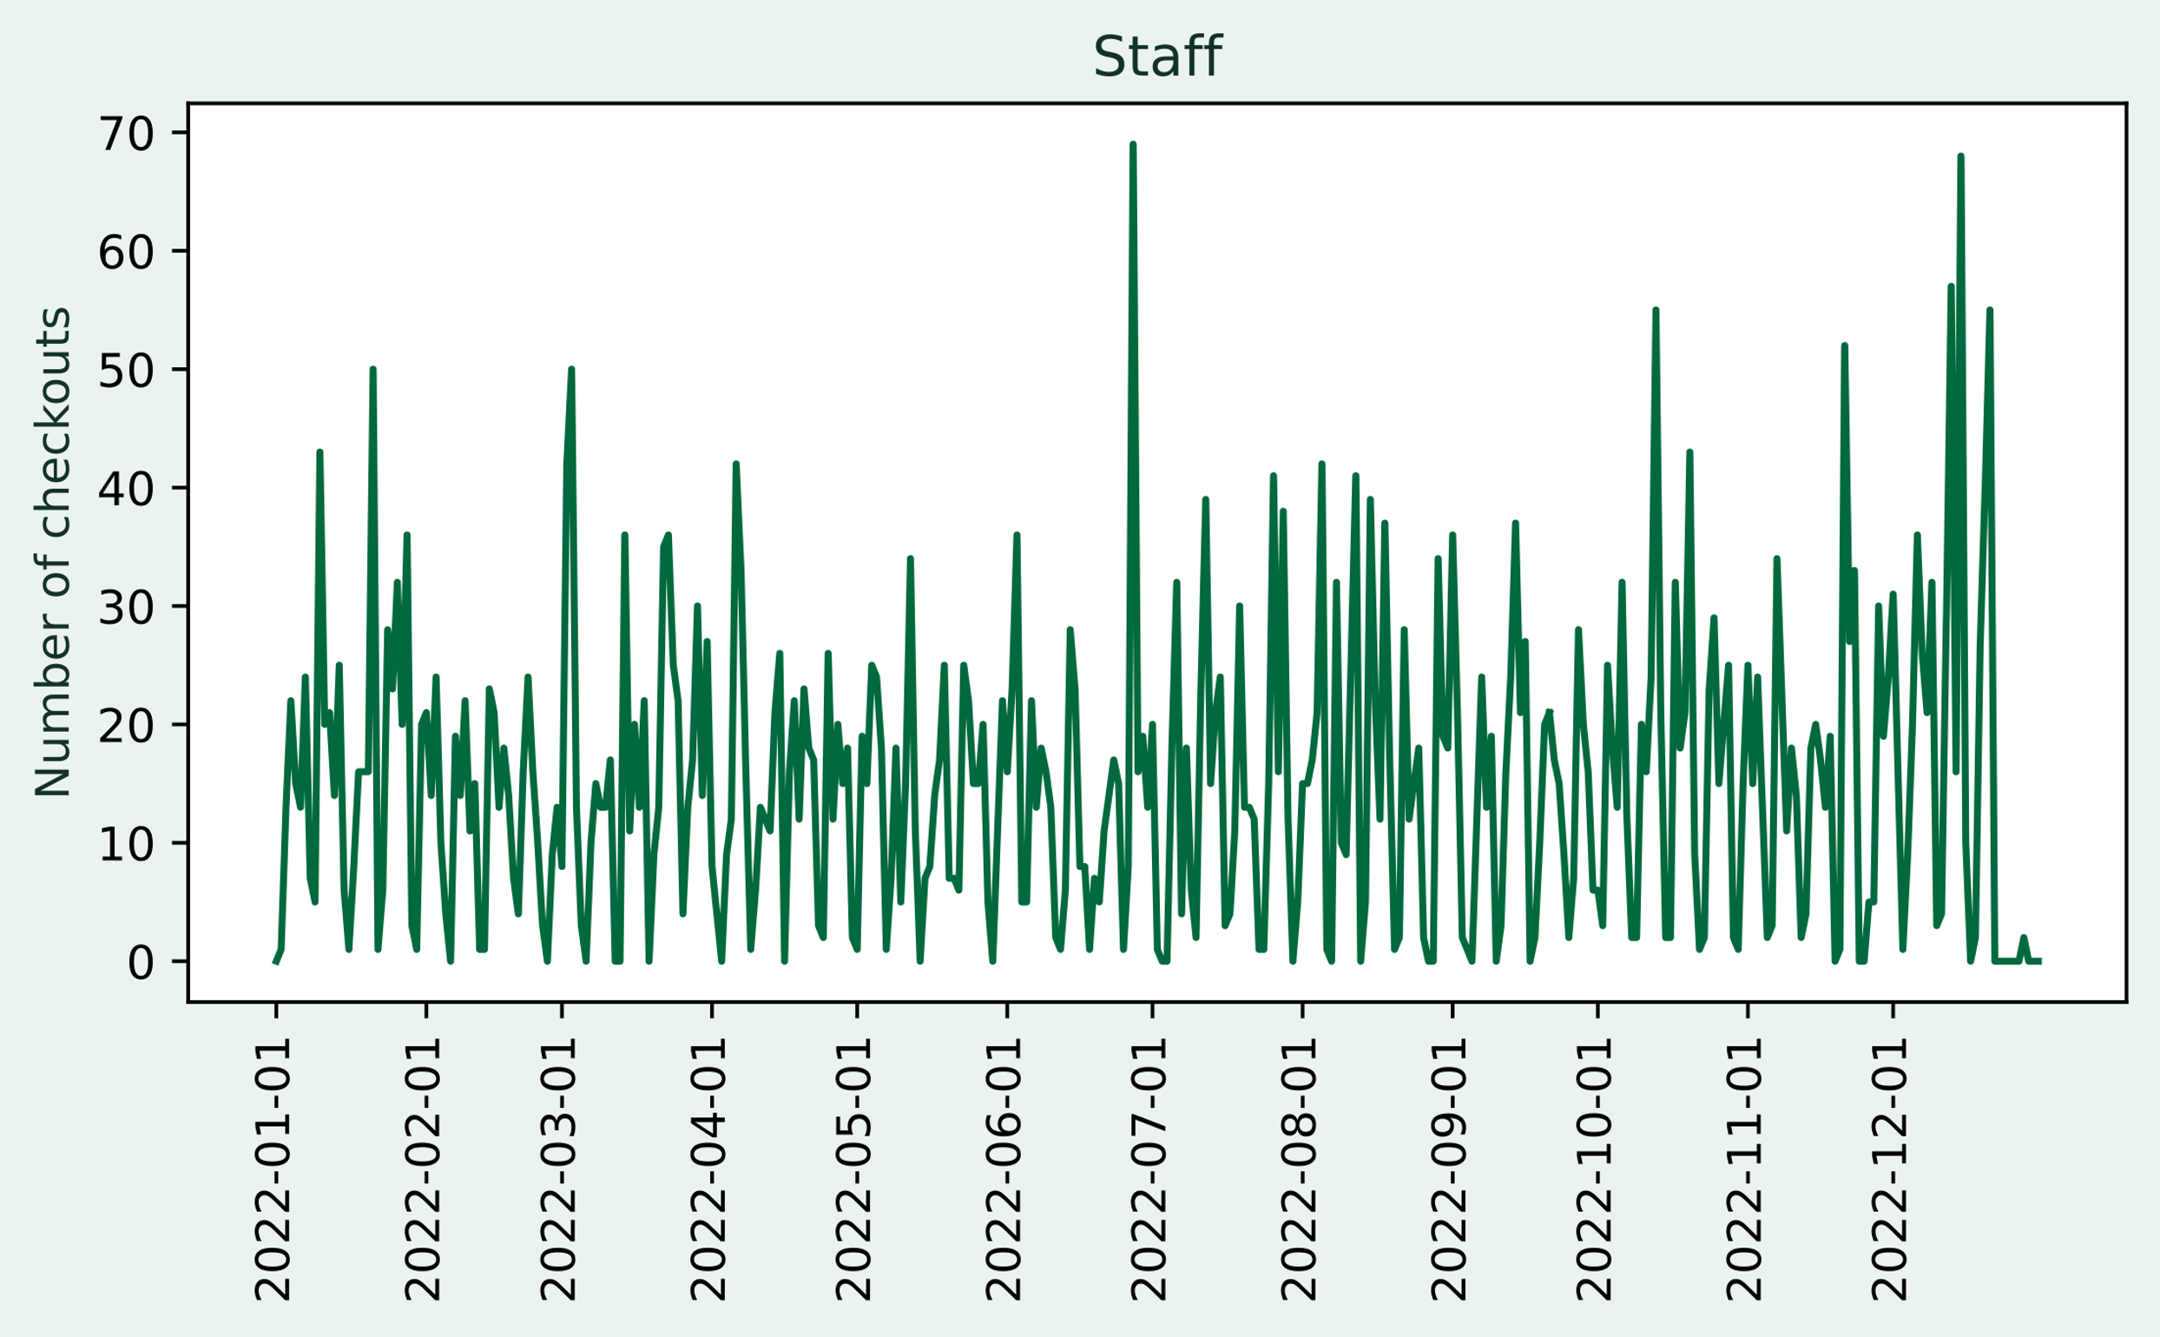
A basic line plot of the staff’s checkouts

Slide 12
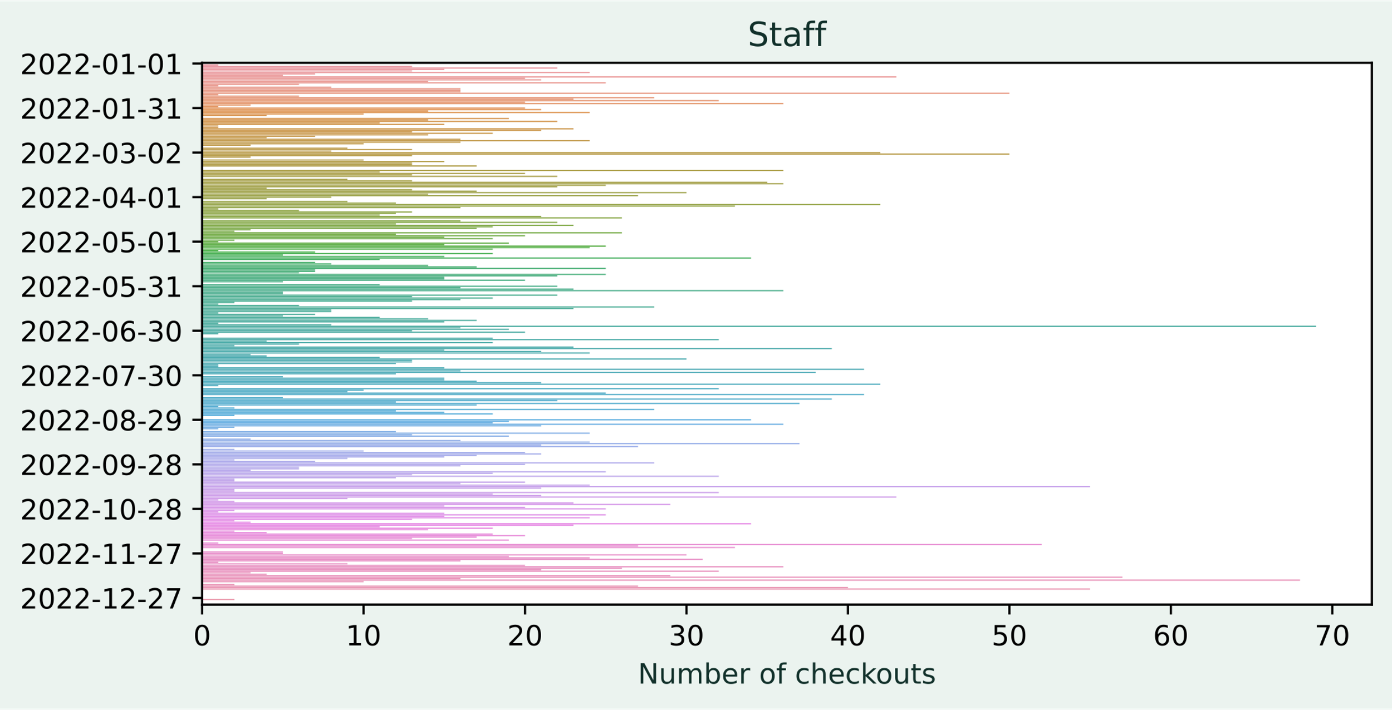
A slightly less boring bar chart

Slide 13
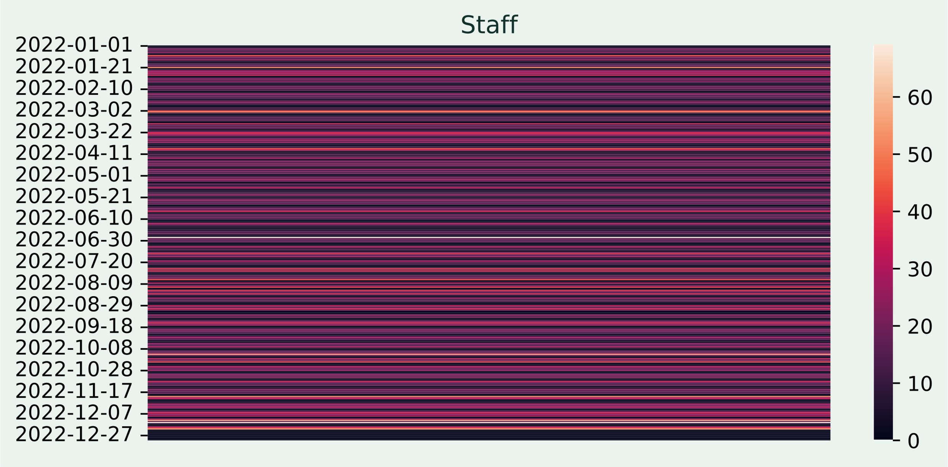
High number of checkouts is a ”hot” day

Slide 14
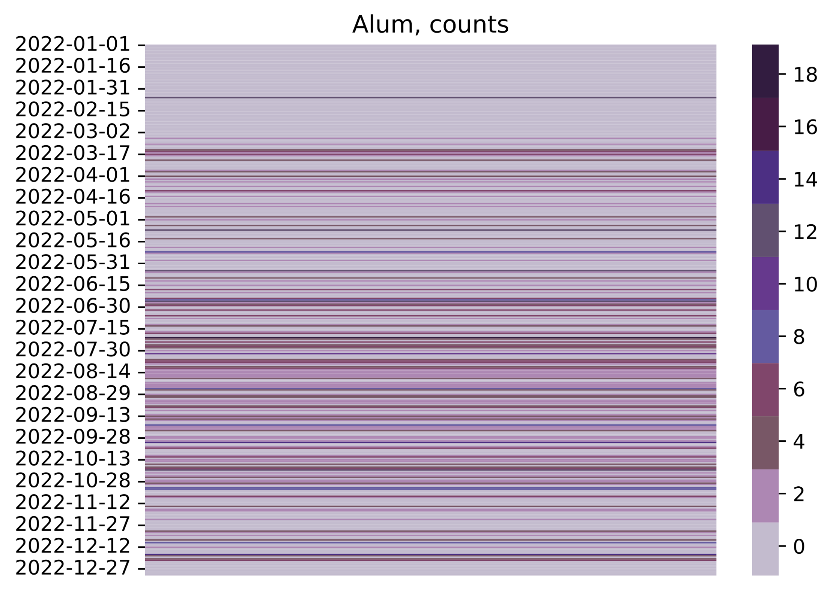
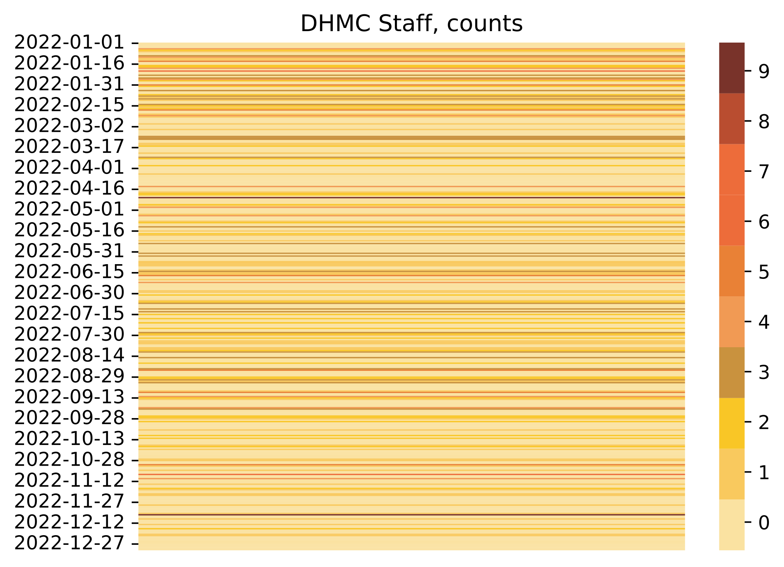
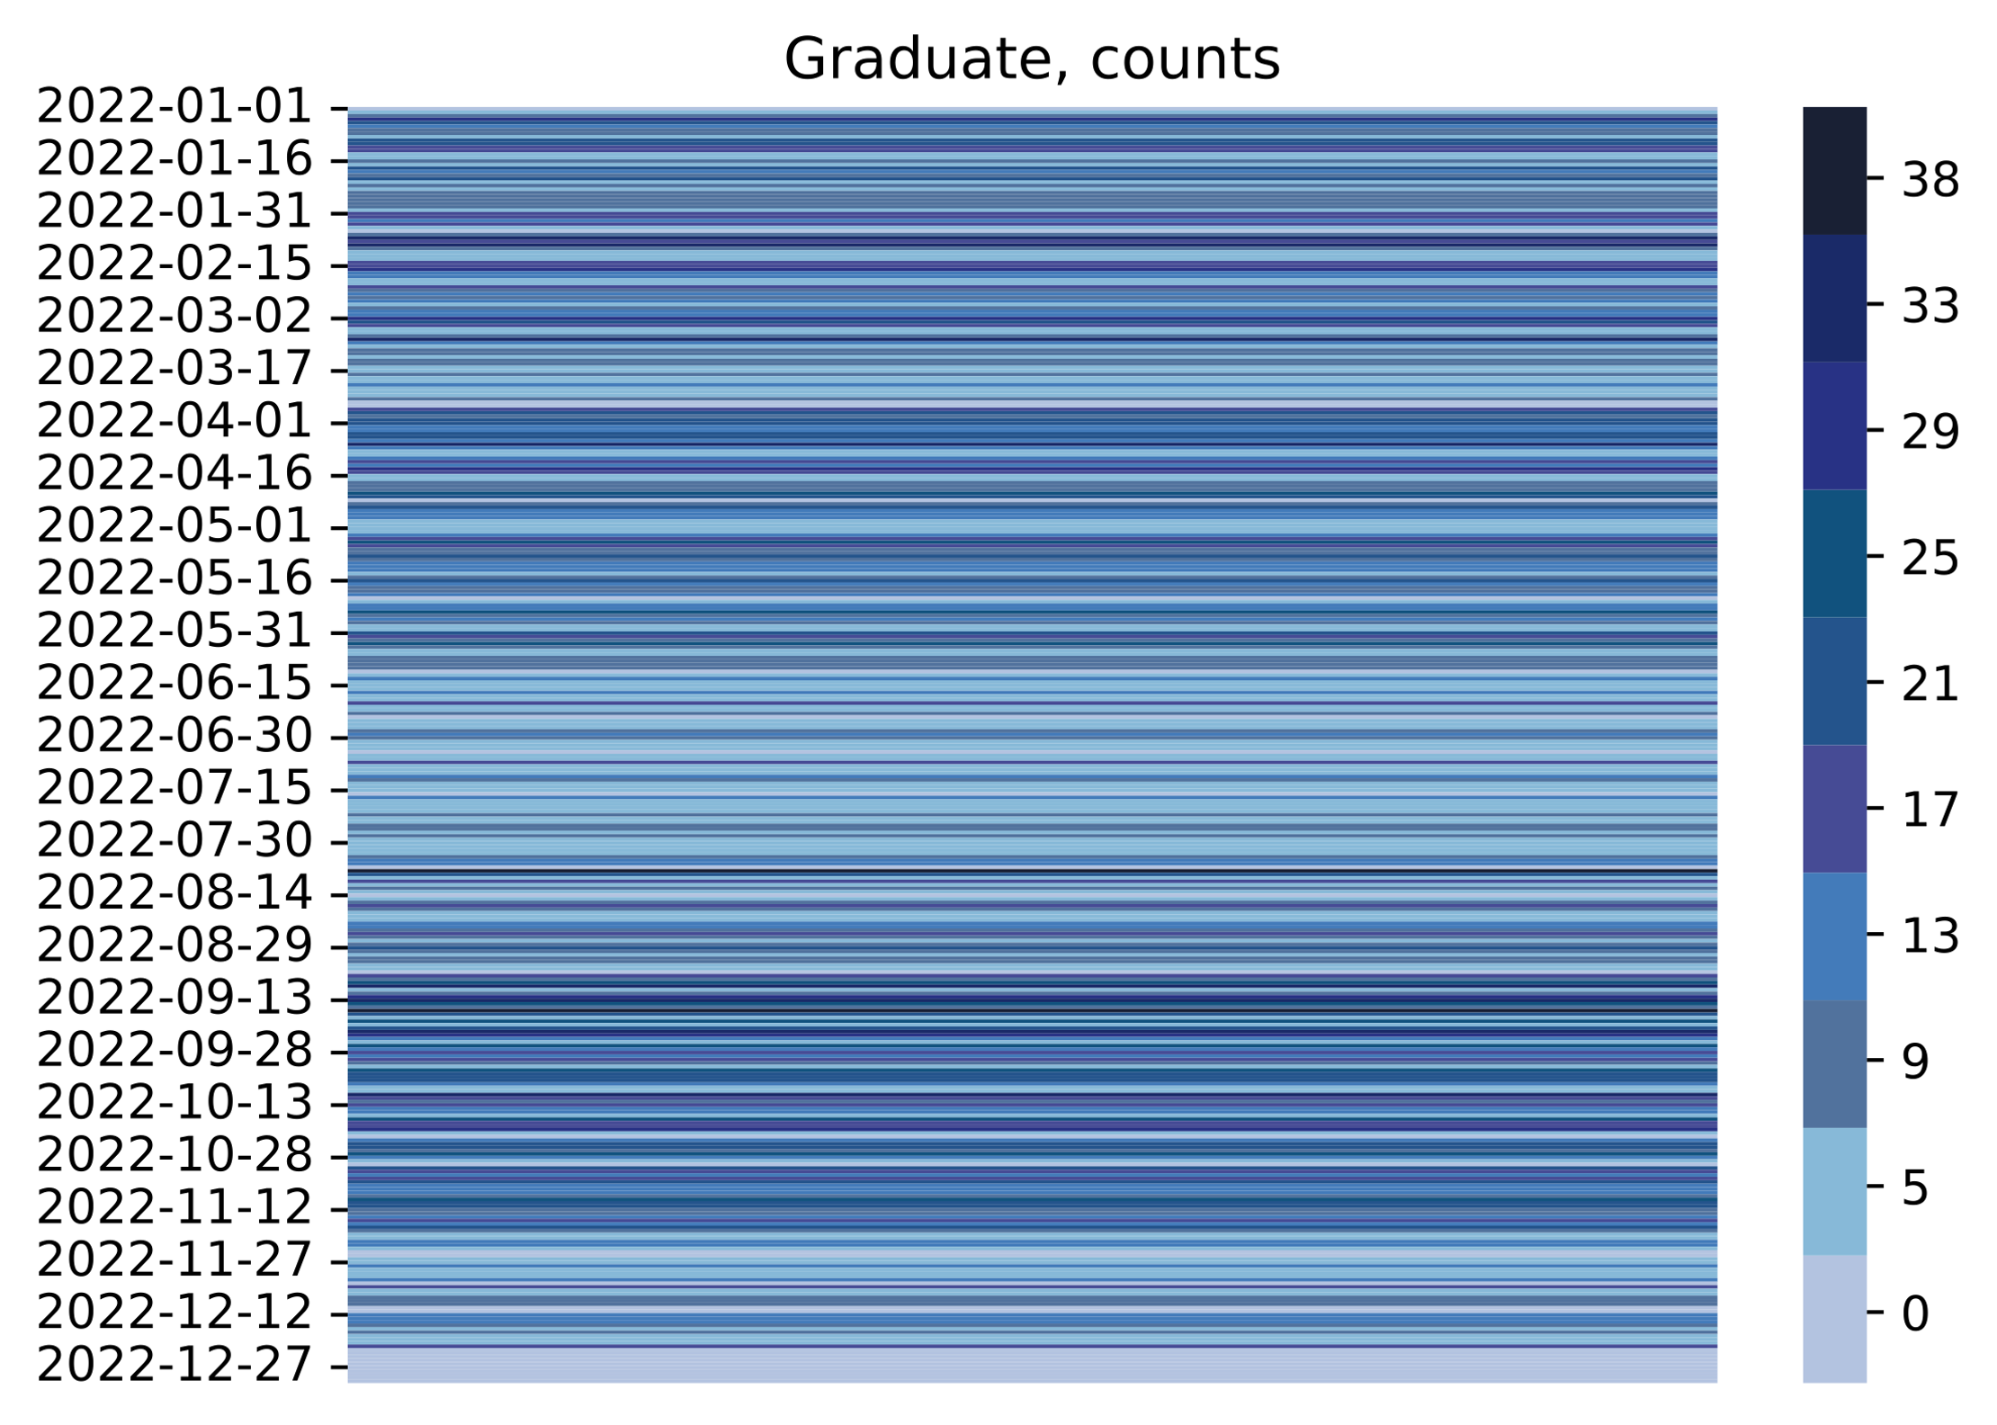
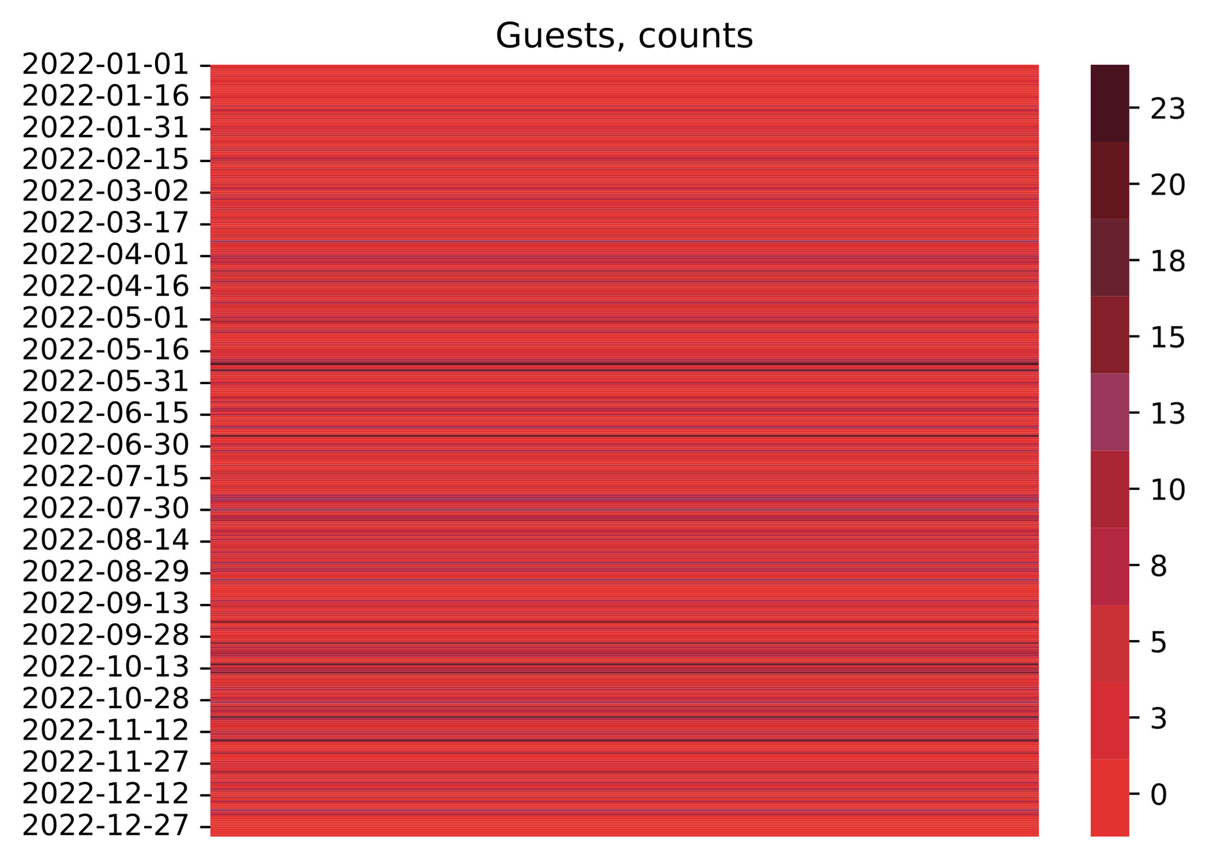
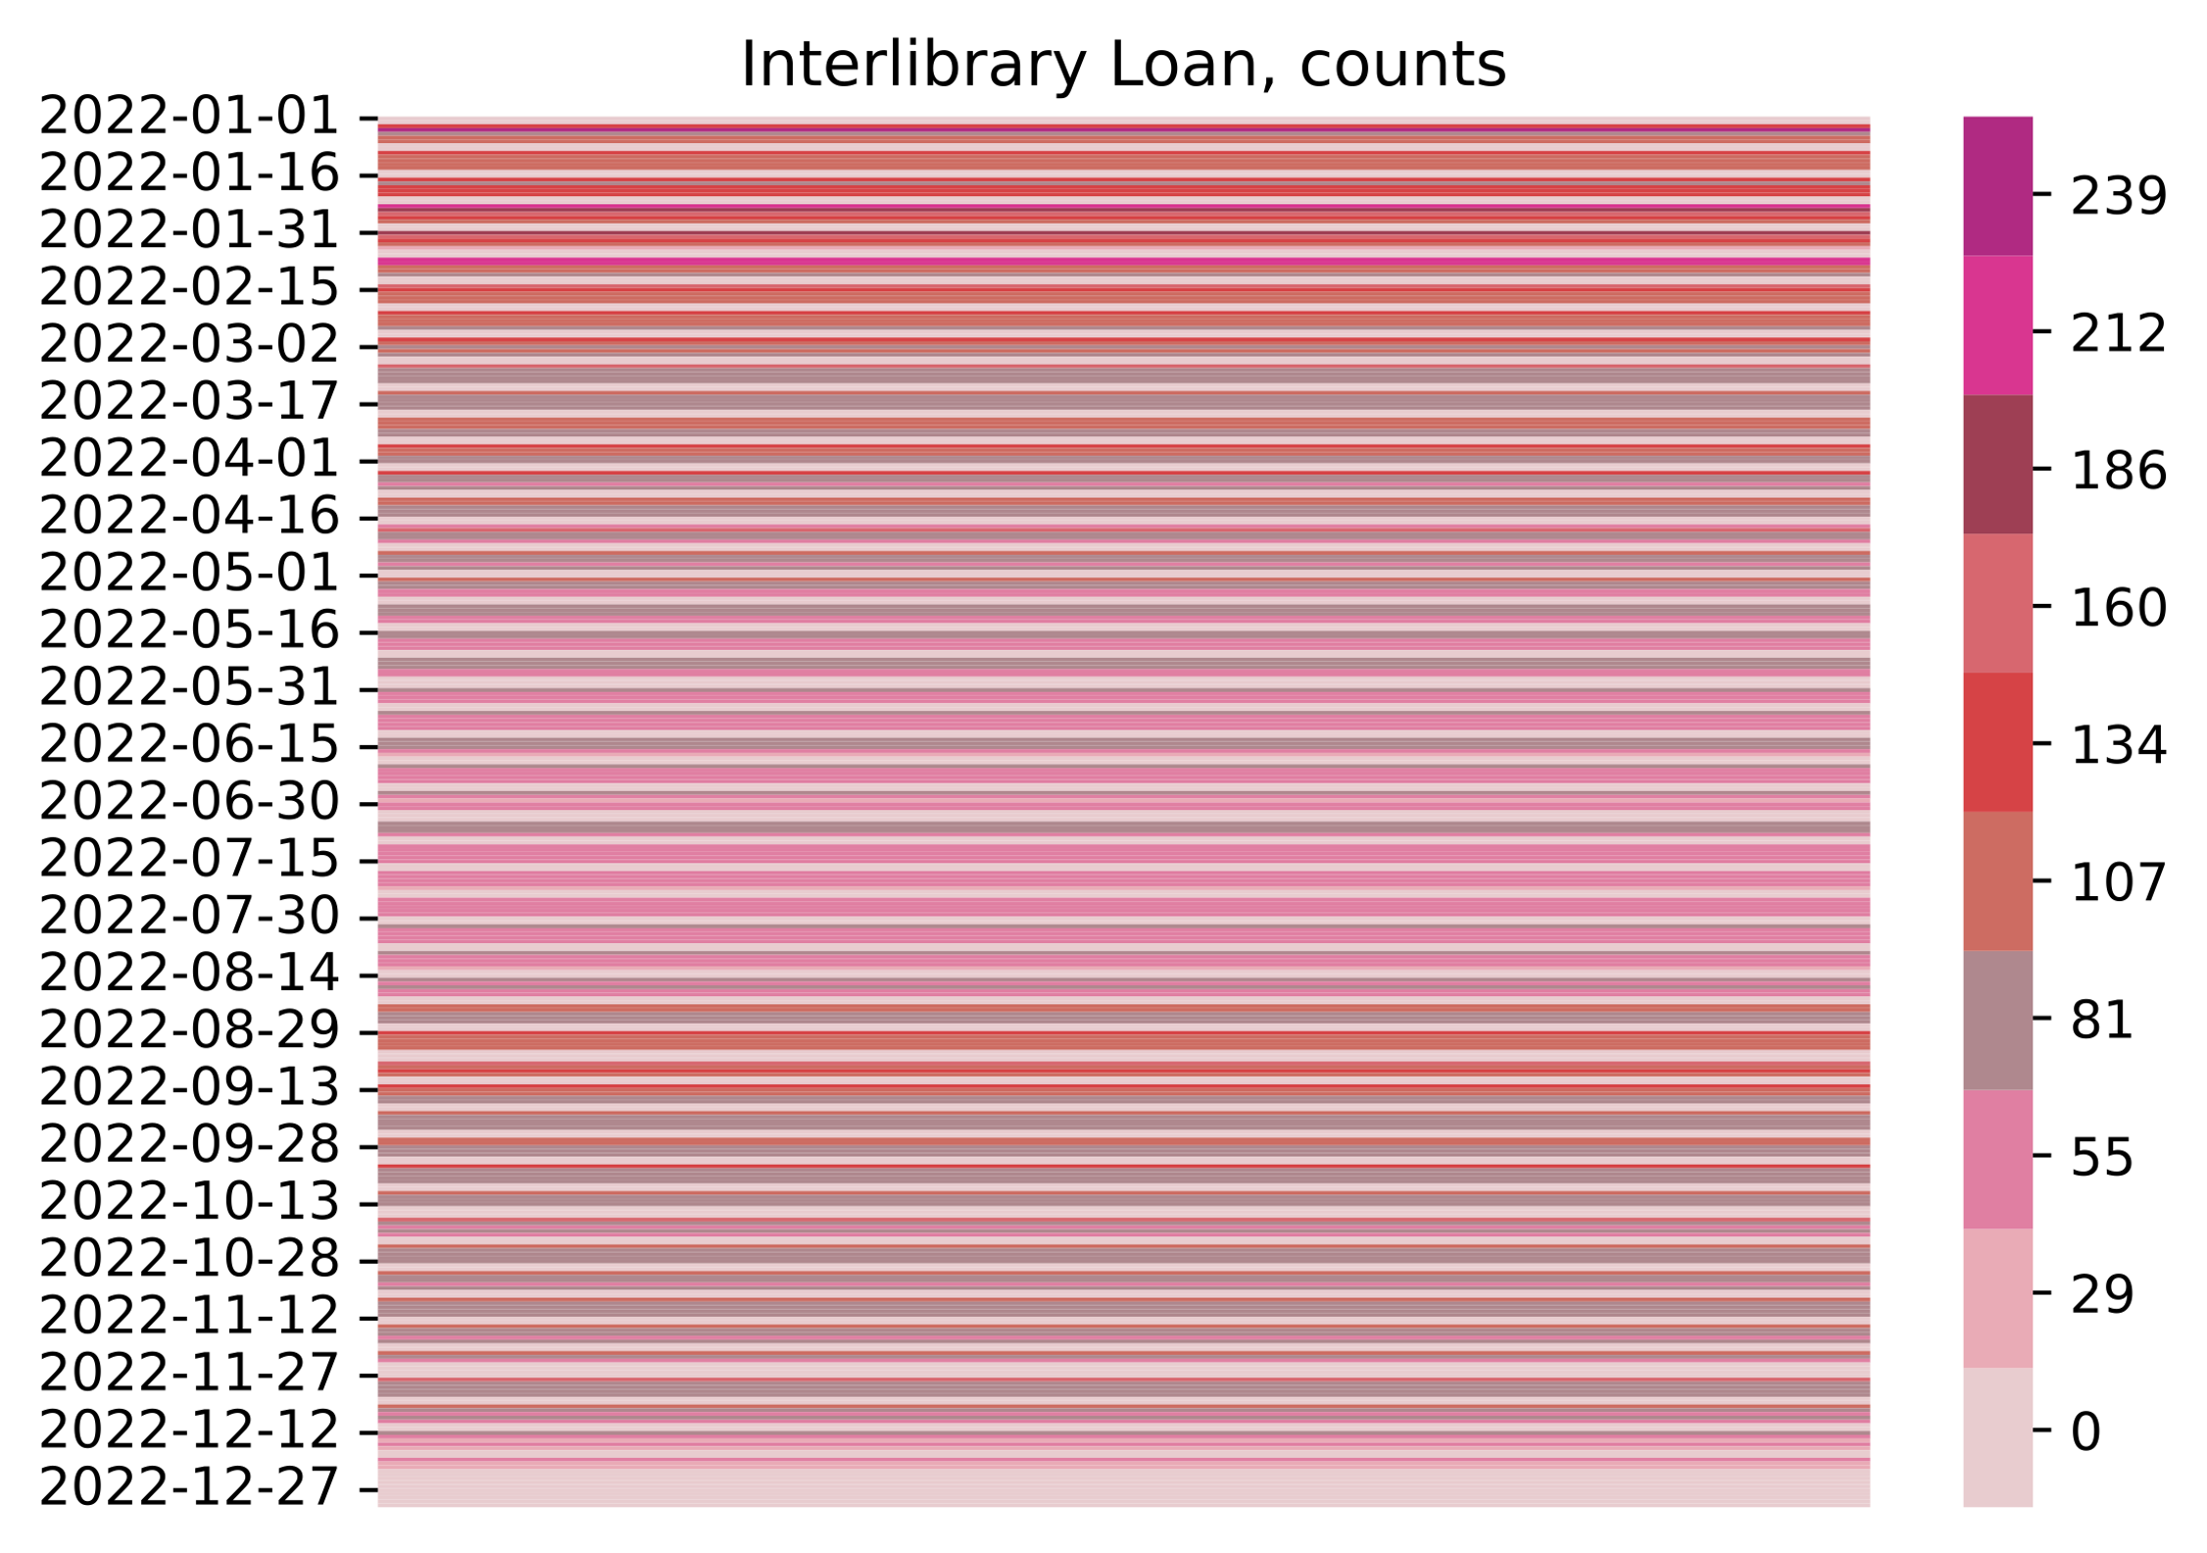
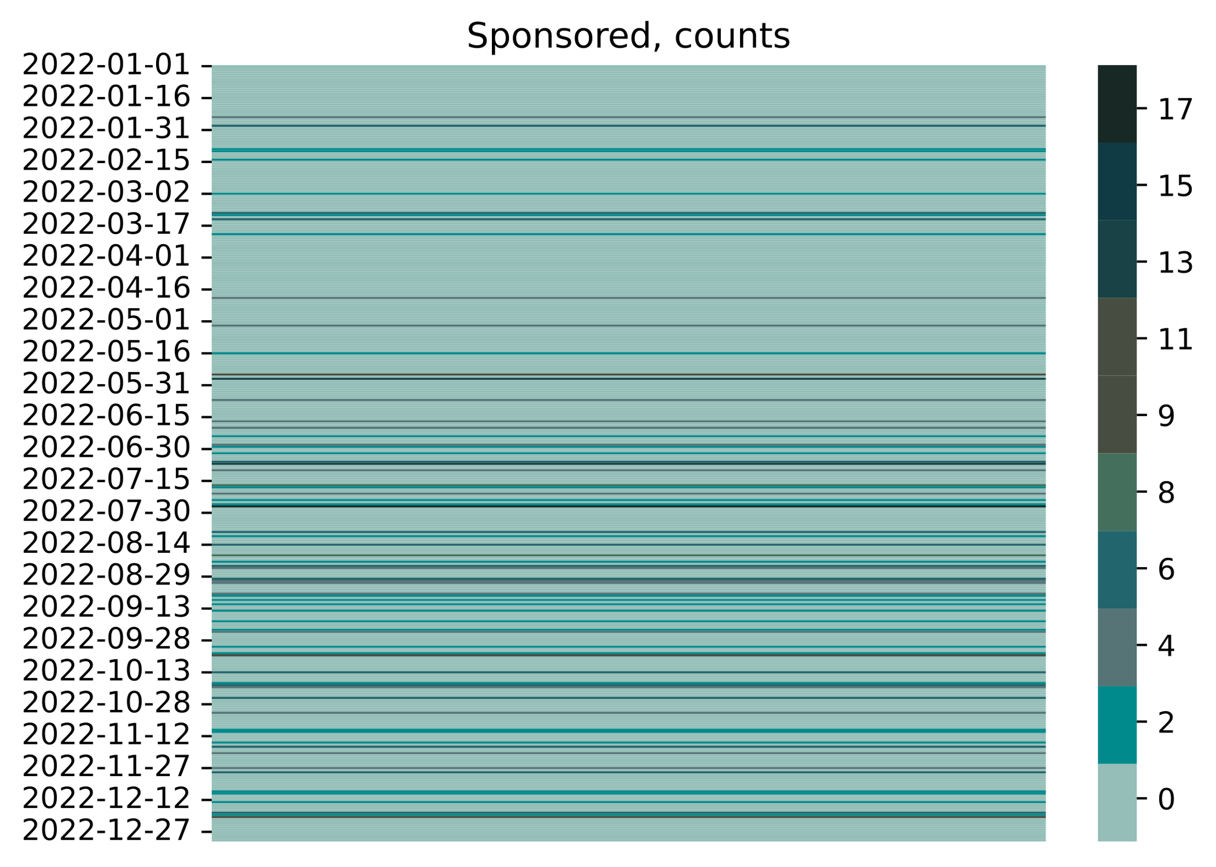
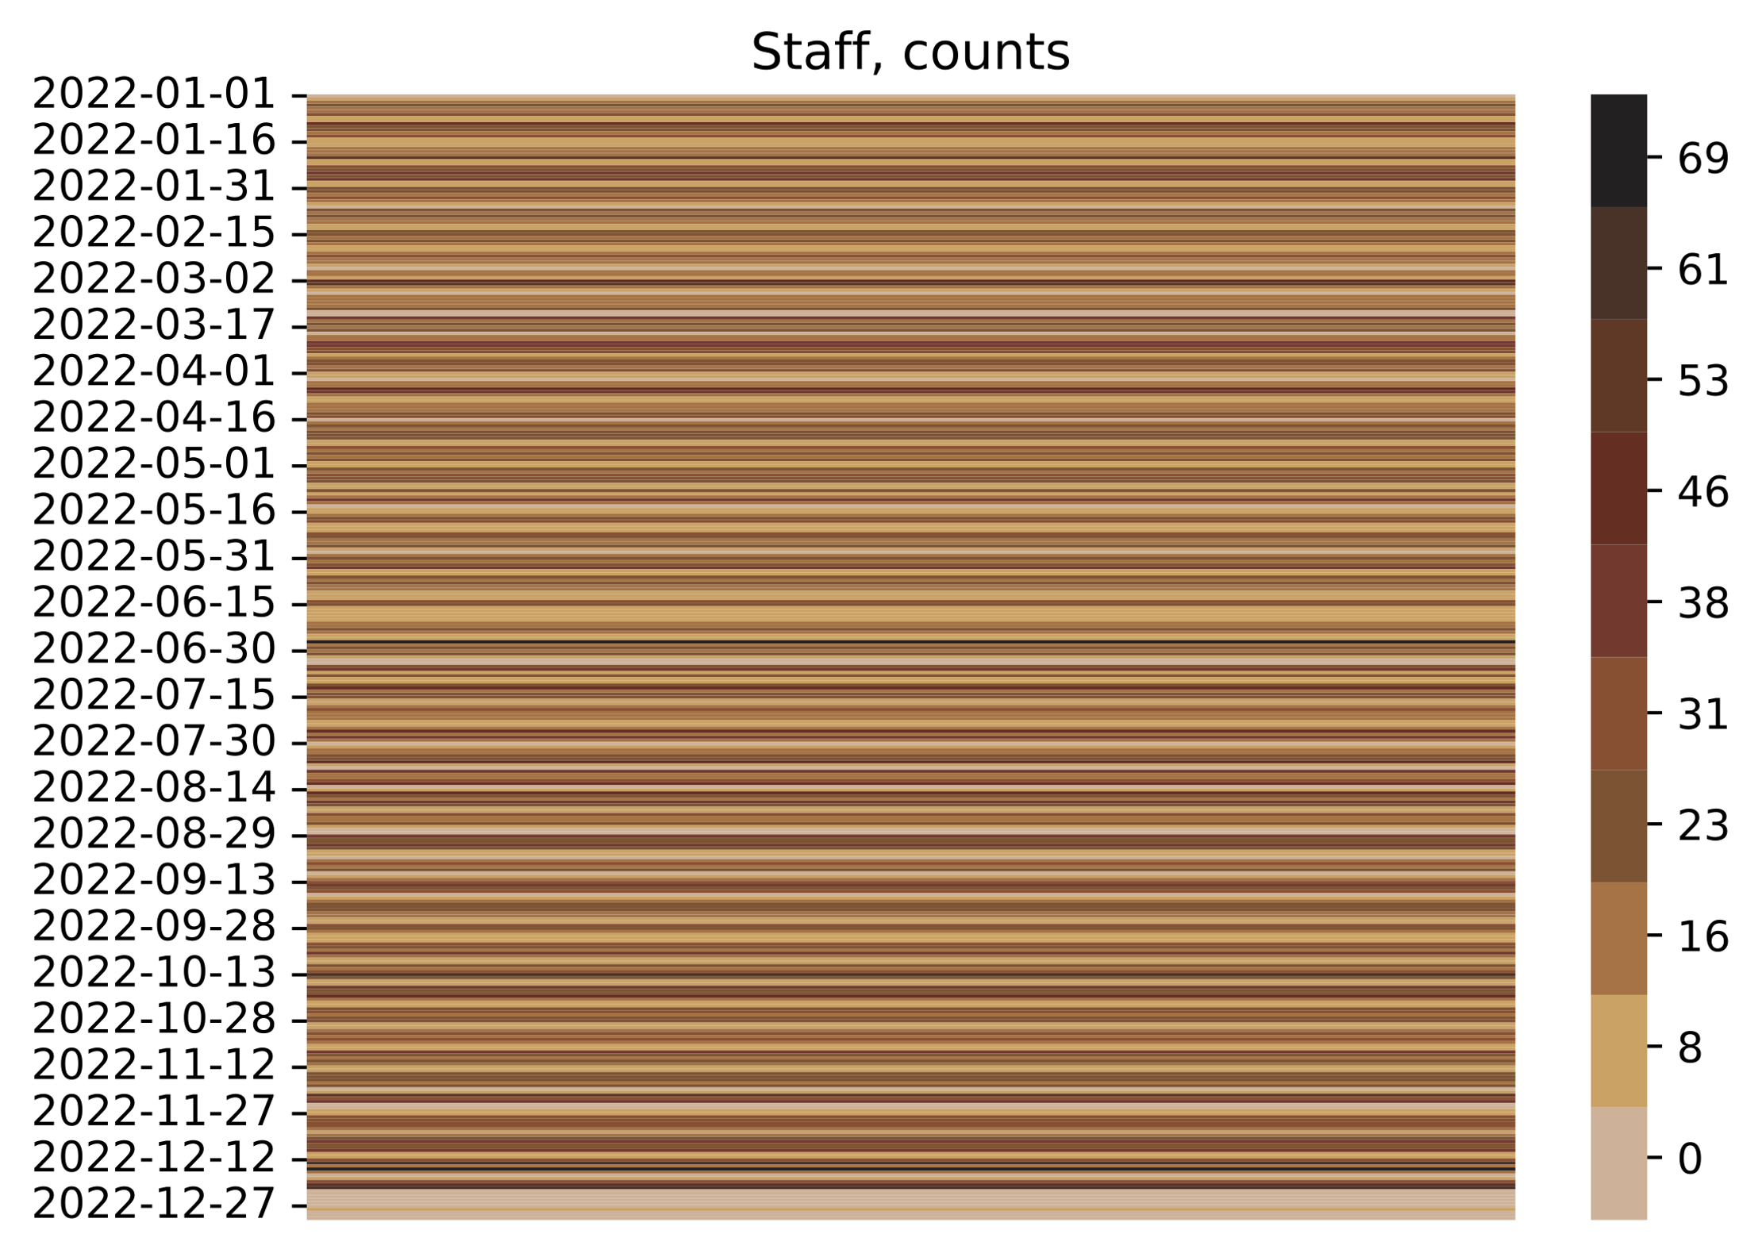
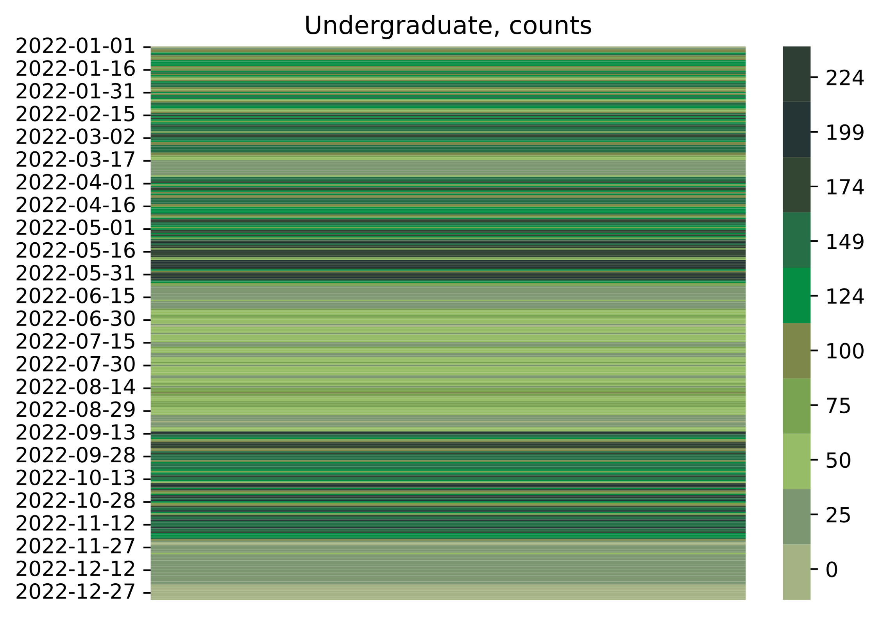
Give each patron group their own color scheme

Slide 15
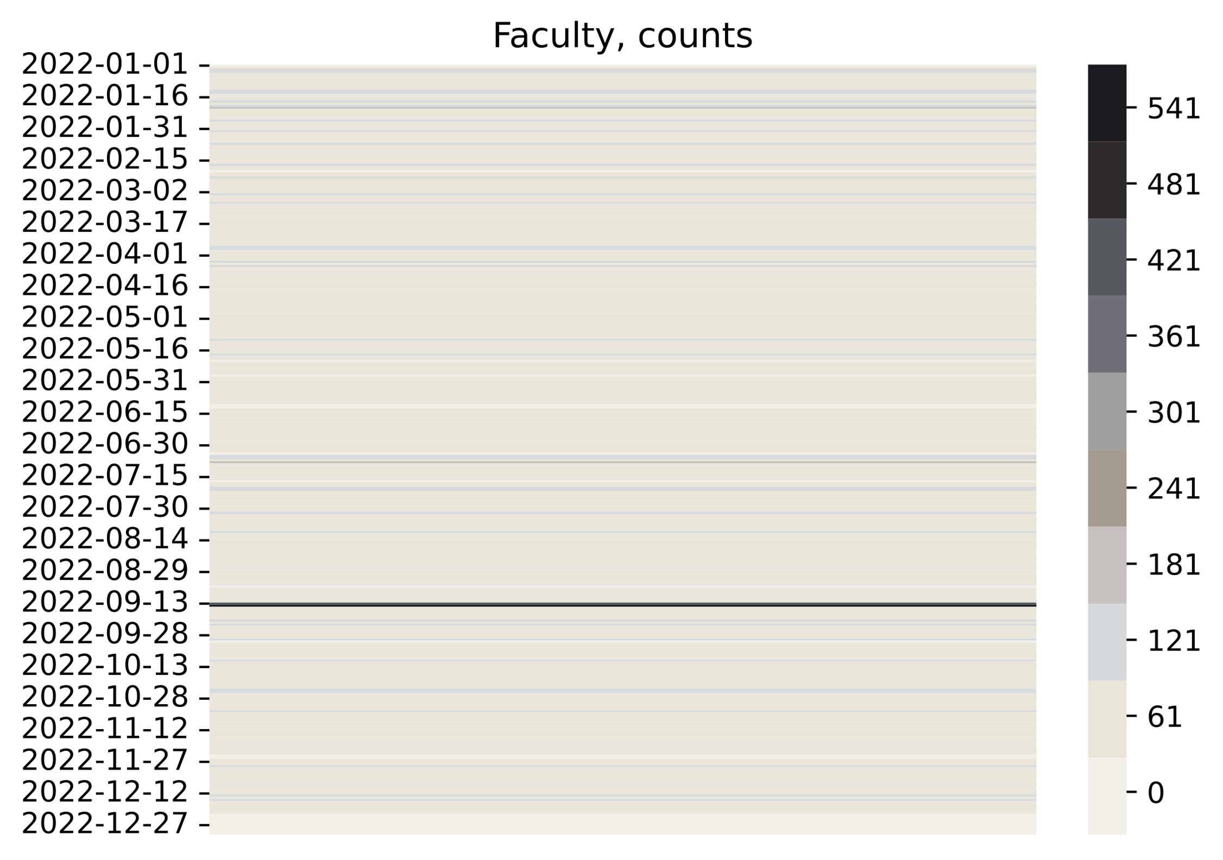
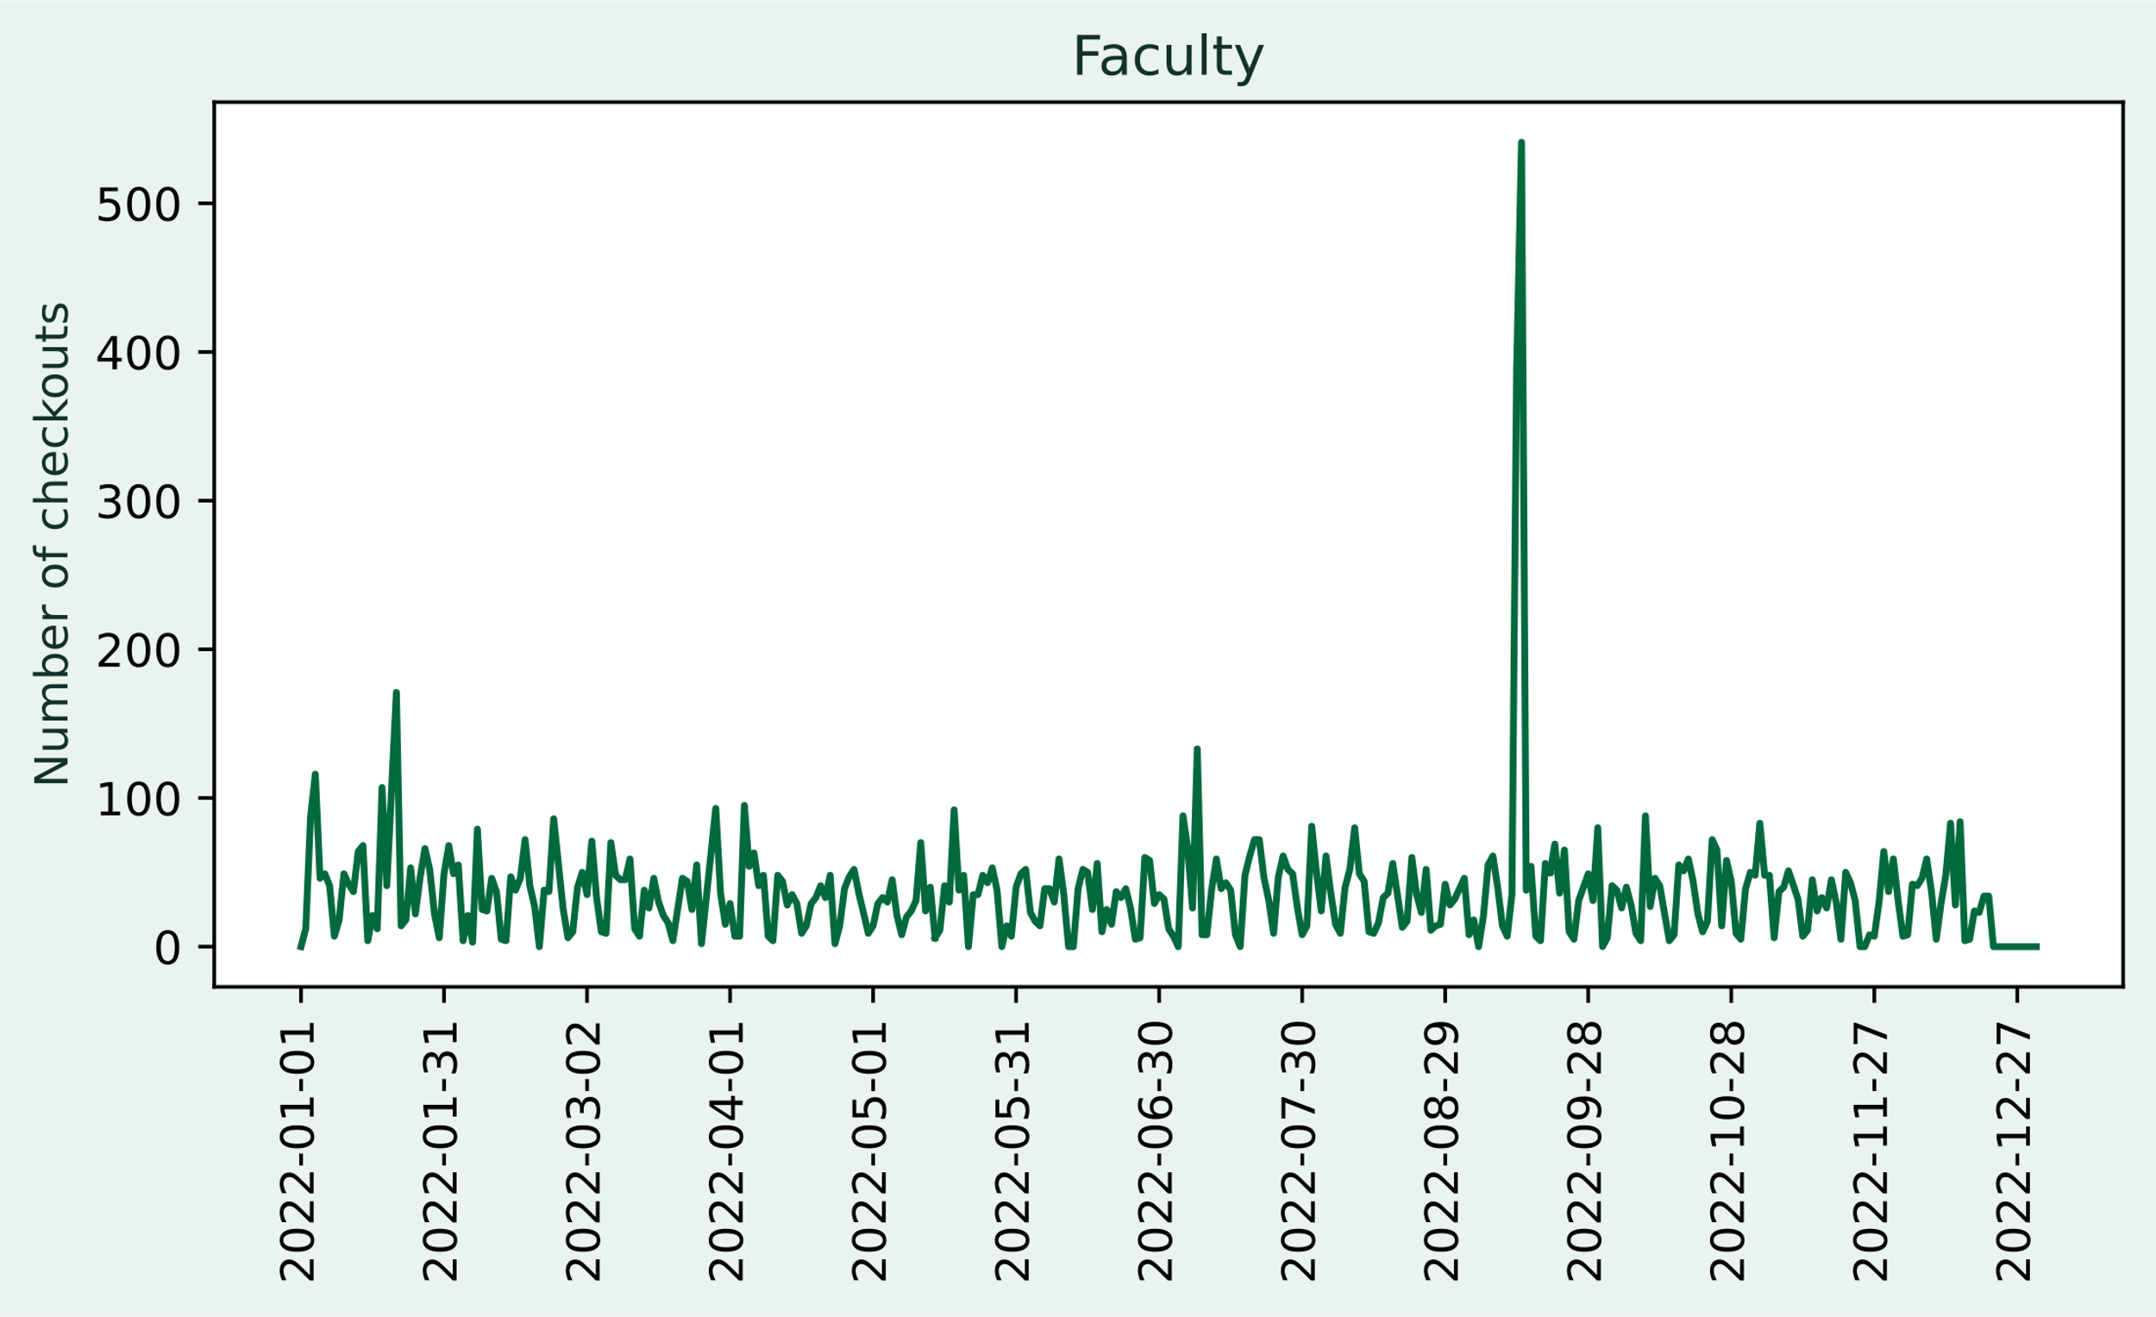
Wait, this one is boring…

Slide 16
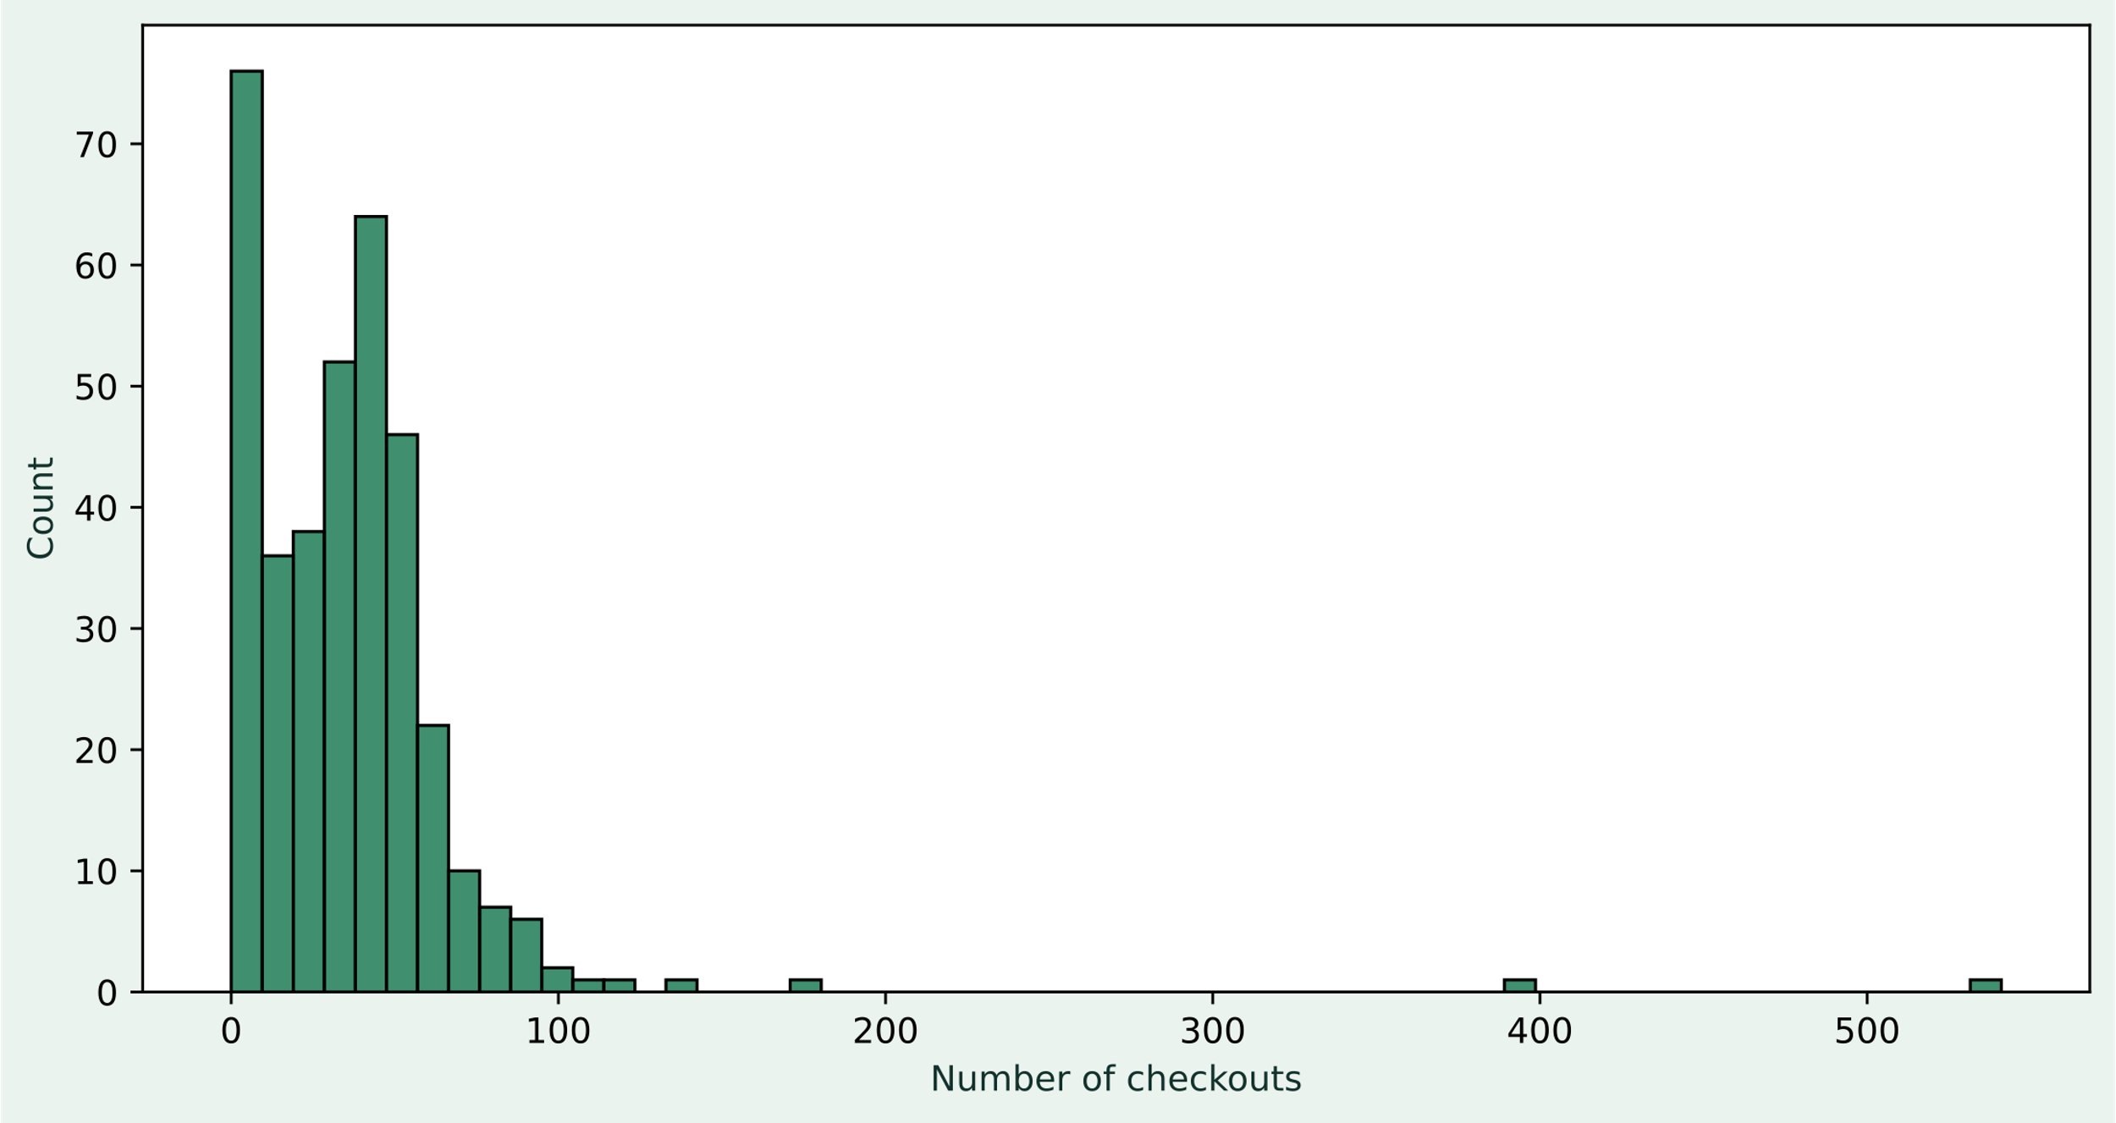

Mapping the number of checkouts to a color

Slide 17
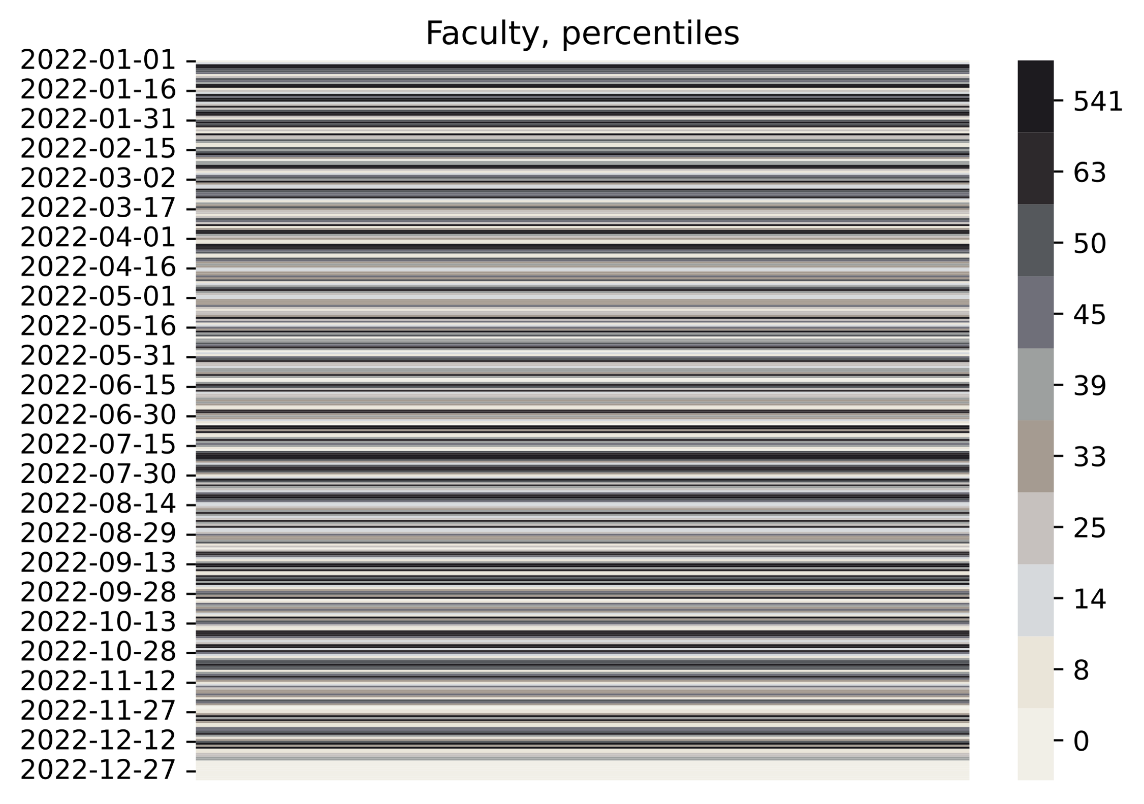

Mapping the number of checkouts to a color

Slide 18
The whole set

Slide 19
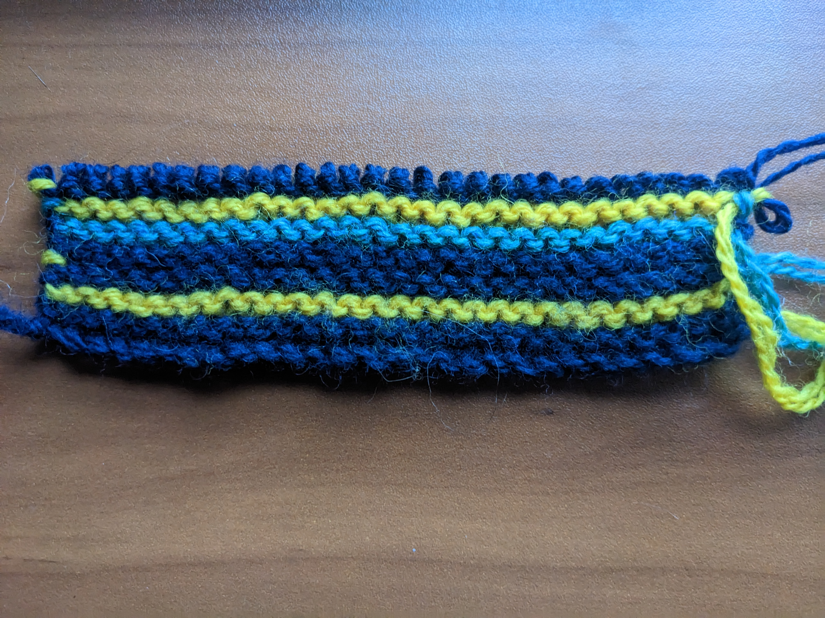
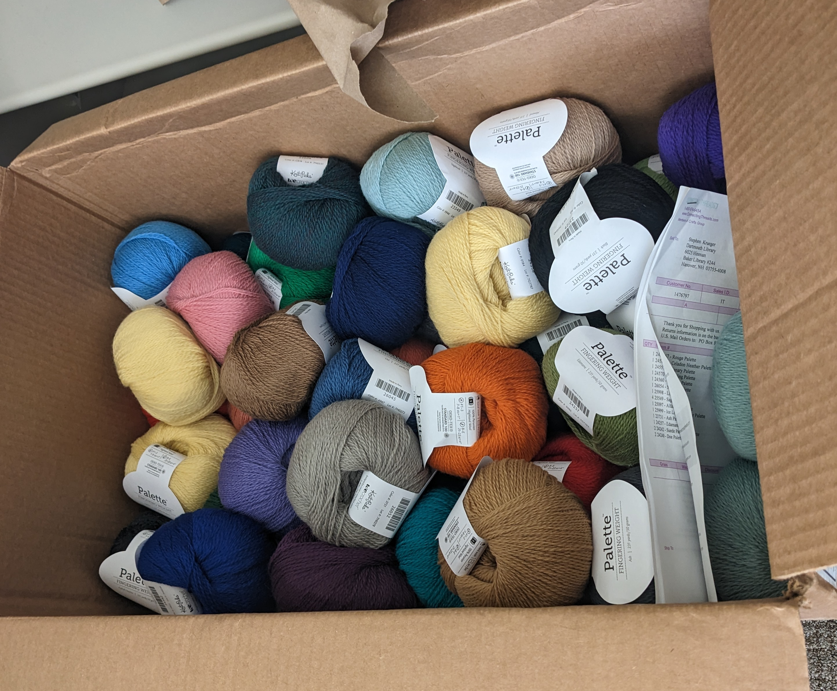
What we've done
Made swatches
Created patterns for knit and crochet
Ordered yarn
Made kits – yarn, pattern, postcard

Slide 20
What you need to do
Select your user group
Pick up your kit or tell us where to mail it
Supply tools or let us know if you need them
Create – when work allows and during scheduled meetups

Slide 21
Outcomes and Future Projects
Omeka Website
Display in Berry
Future craft data projects

Slide 22
Thank you

